Slide 1


GPU Analysis & Prediction Using SAS
Evaluating Performance, Price-Efficiency & Future Trends (2018–2025)
by JAYESHWAR .R

Slide 2





Presentation Objectives
Analyze GPU Performance
Specs vs. gaming & productivity scores
Identify Top GPUs
Best performers & budget-friendly options
Forecast Pricing
ARIMA models for future trends
Develop Selection Framework
Future-proof purchasing decisions

Slide 3

Dataset & Key Metrics
Metric
Description
Memory Size
VRAM capacity in GB
Clock Speeds
GPU core & boost clock frequencies
Shaders
Number of processing units
Gaming Score
Benchmarking for gaming performance
Productivity Score
Benchmarking for creative tasks
INR Price
Price in Indian Rupees
Release Year
Year of market introduction
Future-Proof Score
Longevity and relevance projection

Slide 4
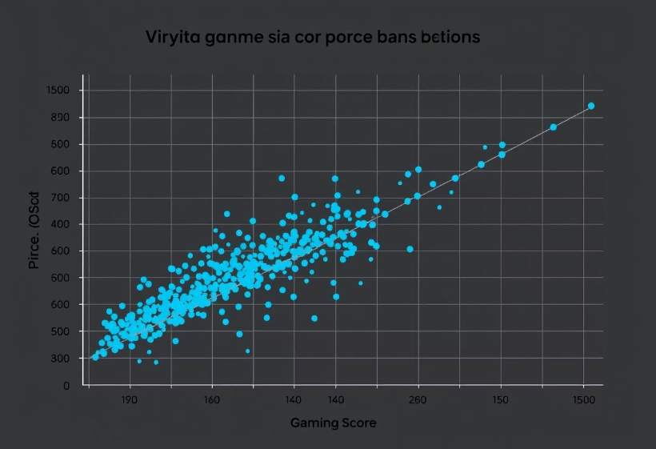
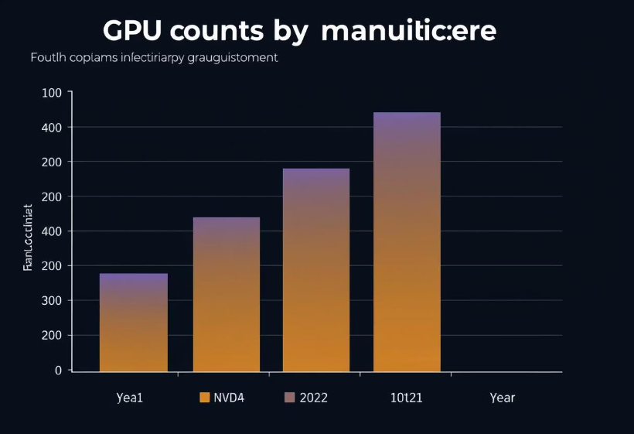
Exploratory Data Analysis
Gaming Score vs. Price: Identifying performance tiers
GPU Distribution: Manufacturer & release year trends

Slide 5
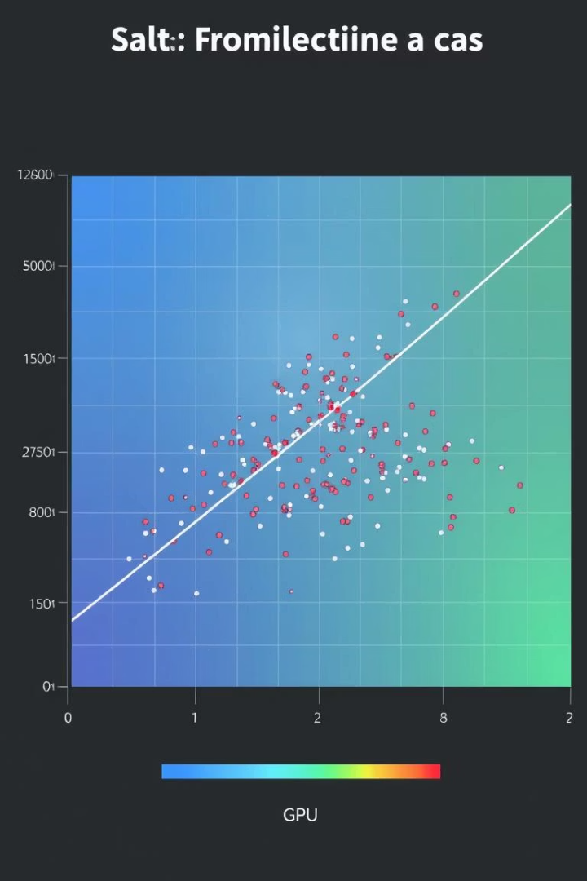
Feature Correlations
Key relationships:
Memory Size: Strong positive correlation with productivity
GPU Clock: Significant impact on gaming performance
Shaders: Directly tied to overall processing power

Slide 6
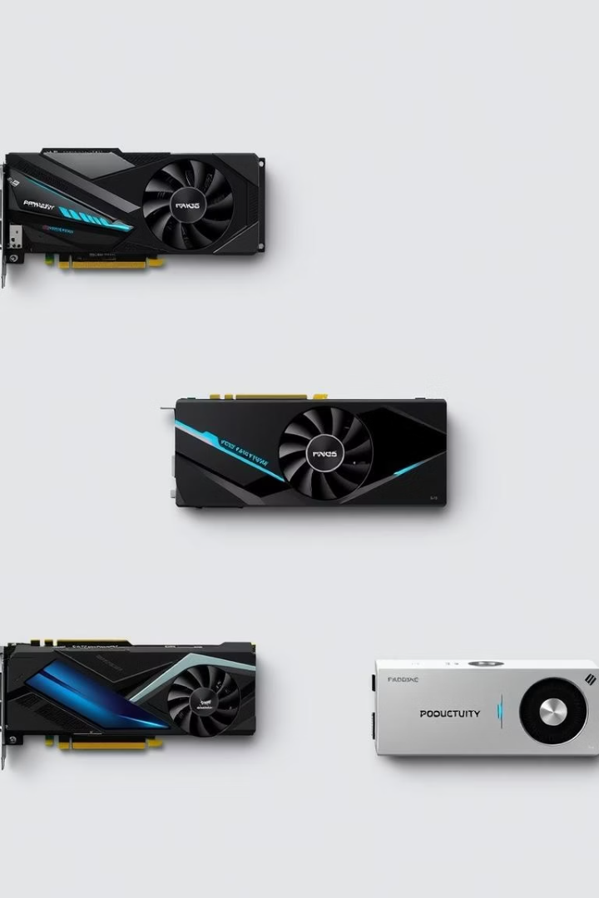
Top 10 GPUs by Category
Gaming Powerhouses
Productivity Champions
NVIDIA GeForce RTX 4090
AMD Radeon RX 7900 XTX
NVIDIA RTX A6000
NVIDIA GeForce RTX 4080
AMD Radeon Pro W6800
NVIDIA GeForce RTX 3090
Best Price-Performance
AMD Radeon RX 6600
NVIDIA GeForce RTX 3060
AMD Radeon RX 6700 XT

Slide 7
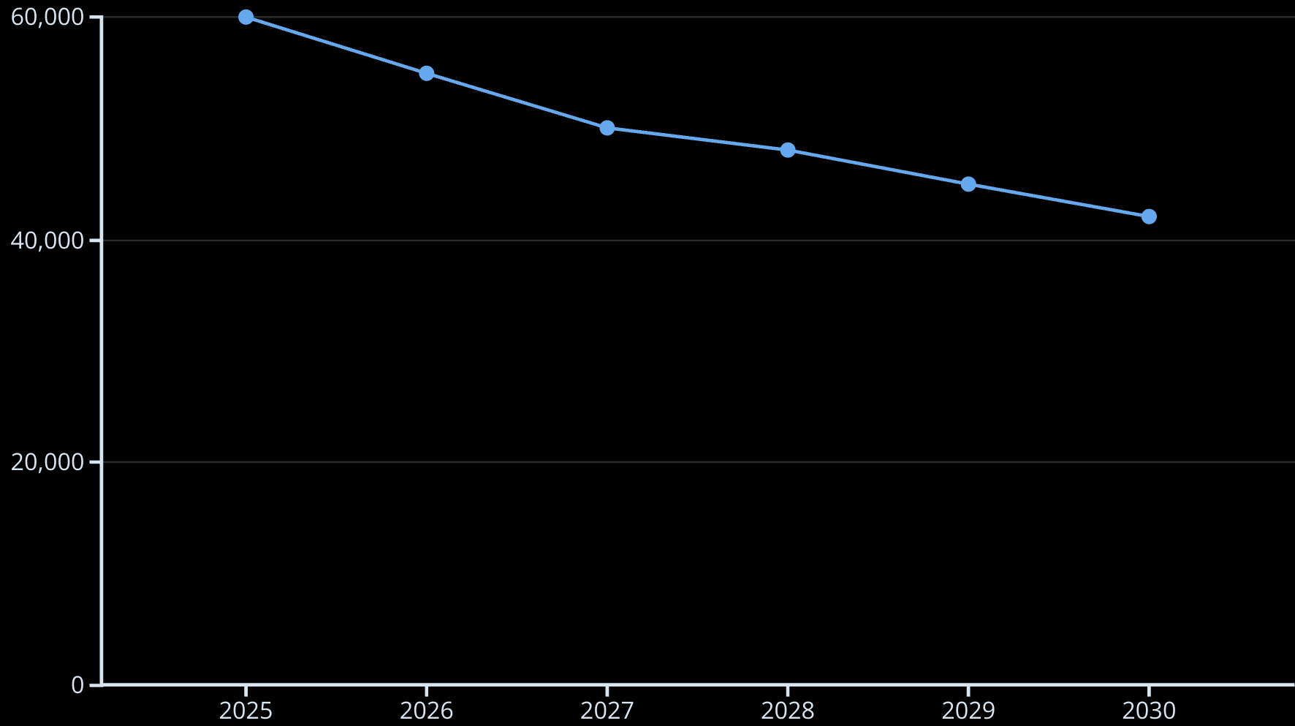
Forecasting GPU Prices (2025–2030)
ARIMA model predicts a gradual price decline.

Slide 8
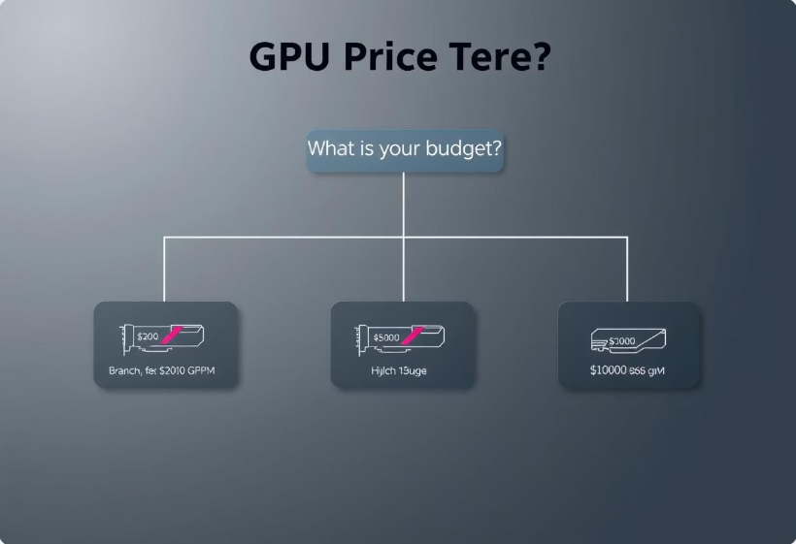
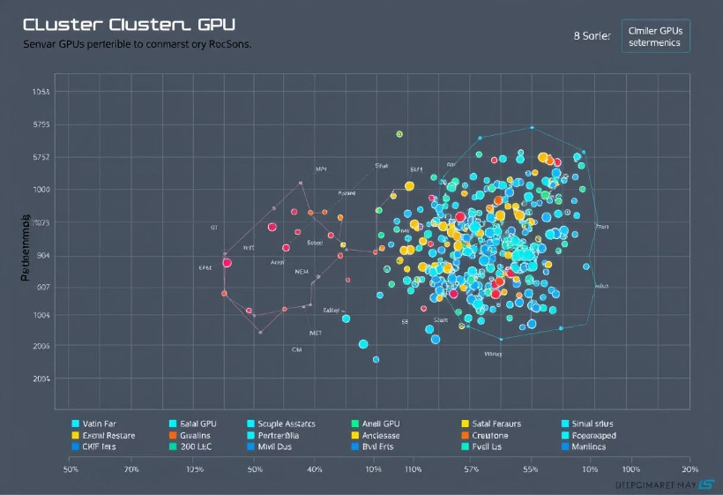
Advanced Analytics
Price Tier Classification
GPU Clustering
Decision tree model for pricing strategies
Grouping similar GPUs for targeted marketing

Slide 9





Recommendations & Next Steps
Budget Gaming
Focus on mid-range AMD RX series
Creative Productivity
Prioritize high VRAM NVIDIA RTX cards
Timing Purchases
Leverage forecast dips for best deals
Future Exploration
AI-driven benchmarking for evolving needs

Slide 10
Conclusion
Key Findings:
Performance correlates with key specs
Price trends show a gradual decline
SAS models provide robust insights
Objectives Achieved:
Comprehensive GPU analysis
Actionable purchasing recommendations
Future-proof selection framework

